Slide 1
After studying this chapter you should be able to:
Understand the different characteristics of a product mix.
Recognize the stages and characteristics of the product life cycle.
Identify appropriate marketing strategies for products in different life cycle stages.

Slide 2
After studying this chapter you should be able to:
Describe the limitations of the product life cycle concept.
Discuss different product-mix and product-line strategies.

Slide 3

Product Mix
Product Mix:
  The total assortment of products and services marketed by a firm.
Product Line:
  A group of individual products that are closely related in some way.
Individual Product:
  Any brand or variant of a brand in a product line.

Slide 4

Product Mix Characteristics
Product Mix Width:
  The number of product lines in the product mix.
Product Line Length:
  The number of products in a product line.
Product Mix Consistency:
  The relatedness of the different product lines in a product mix.

Slide 5
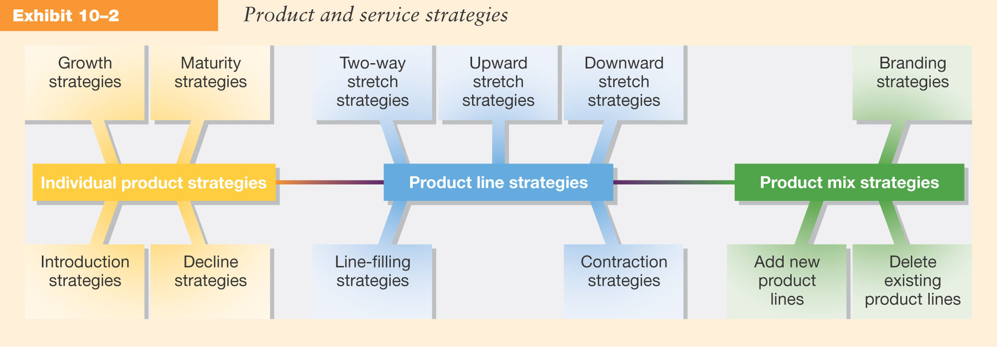
Product and Service Strategies

Slide 6
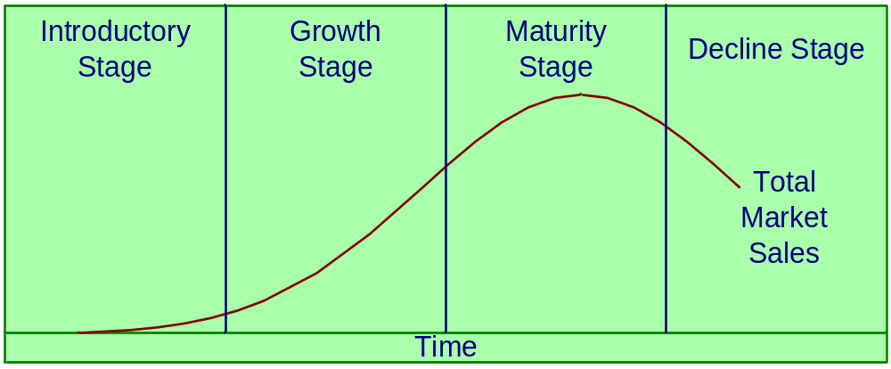
Individual Product Strategies
Product Life Cycle (PLC):
  Describes the advancement of products through identifiable stages of their existence.

Slide 7
The Product Life Cycle

Slide 8
The Product Life Cycle Concept is Based on Four Premises
Products have a
limited life.
Profits from a product
vary at different stages
in the life cycle.
Product sales pass through
distinct stages, each with
different marketing
implications.
Products require different
strategies at different
life cycle stages.

Slide 9
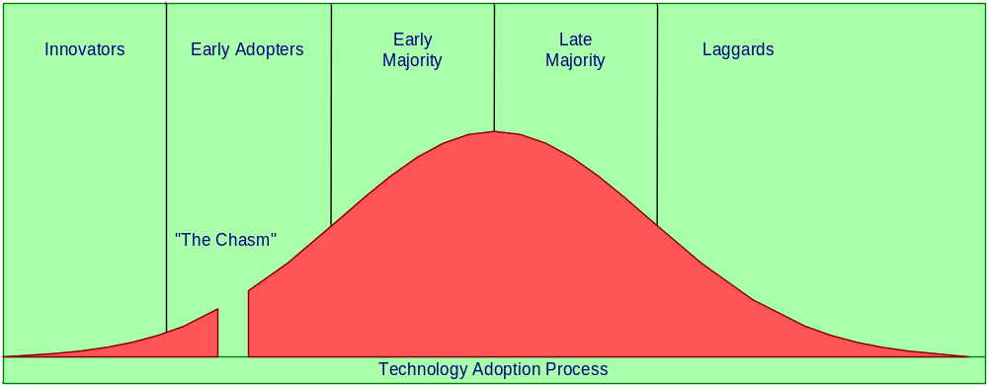
The Diffusion Process
Innovators
(2.5%)
Early Adopters
(13.5%)
Early Majority
(34%)
Late Majority
(34%)
Laggards
(16%)

Slide 10
The Diffusion Process

Slide 11
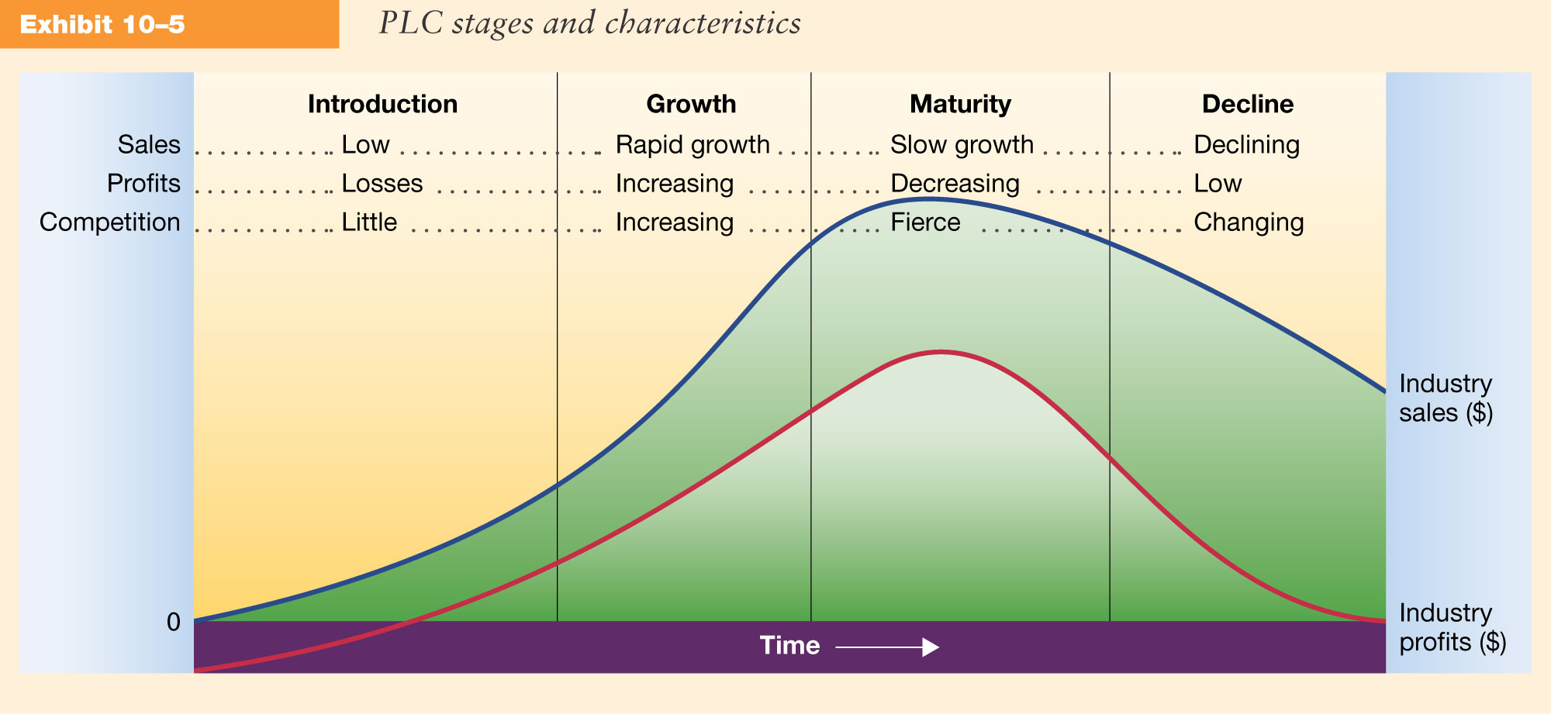
PLC Stages and Characteristics

Slide 12
PLC Length and Shape
Style
Fashion
Fad
Sales
Sales
Sales
Time
Time
Time

Slide 13
PLC Marketing Strategies
Stage Objective Marketing Strategy
Introduction Awareness & trial Communicate benefits
Growth Usage of firm’s brand Specific brand communication,
lower prices, expand distribution
Maturity Maintain market share Sales promotion, drop price,
Extend life cycle expand distribution, new uses
& new versions of product
Decline Decide what to do Maintain, harvest, or divest
with product

Slide 14
Limitations of the PLC
The life cycle concept applies best to product forms rather than to classes of products or specific brands.
The life cycle concept may lead marketers to think that a product has a predetermined life, which may produce problems in interpreting sales and profits.
It is only a descriptive way of looking at the behavior of a product and the life cycle can not predict the behavior of a product.

Slide 15

Product-Line Strategies
Strategic Alternatives:
  To increase the length of a product line.
  To decrease the length of a product line.

Slide 16
Increasing the Product Line
Downward-stretch Strategy
Upward-stretch Strategy
Two-way-stretch Strategy
Line-filling Strategy
Cannibalization occurs when a new
Product takes sales away from
existing products.

Slide 17

Decreasing the Product Line
Product Line Contraction:
  Firms must consider deleting products when:
    They are not successful.
    They reach the decline stage of PLC.
    Long product line marketing costs are too high.

Slide 18
Product-Mix Strategies
The Product Mix consists of all
product lines and individual products
marketed by the firm.

Slide 19

Strategic Alternatives
Add New
Product Lines?
Delete Existing
Product Lines?

Slide 20
Branding Strategies
Individual Brand
Name Strategy
Family & Individual
Brand Name
Product Mix
Branding Strategies
Family Brands or
Product Types
Family Brand
Name Strategy
Company
Name

Slide 21

Ethical Issues in Product and Service Strategies
Is the product safe when used as intended?
Is the product safe when misused in a way that is foreseeable?
Have any competitors’ patents or copyrights been violated?

Slide 22

Ethical Issues in Product and Service Strategies
Is the product compatible with the physical environment?
Is the product environmentally compatible when disposed of?
Do any organizational stakeholders object to the product?

